Slide 1
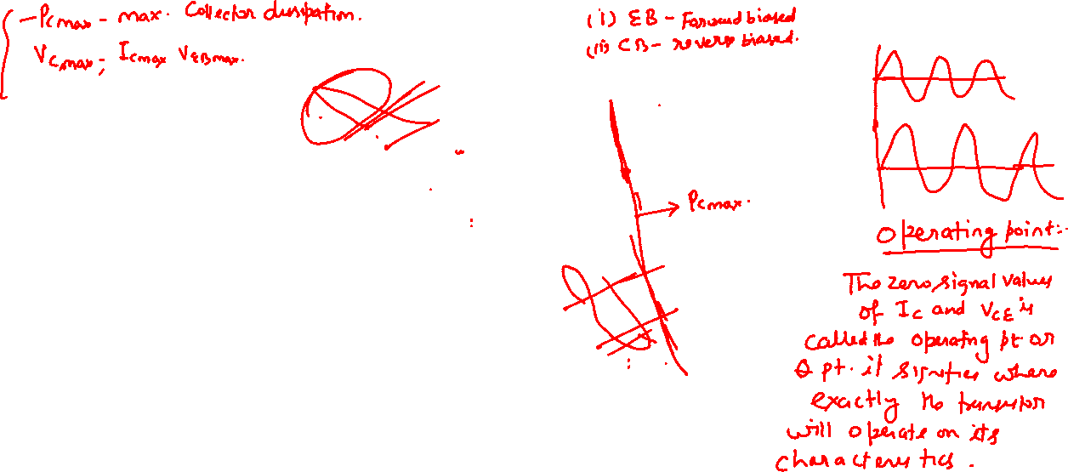

Transistor Biasing

Slide 2
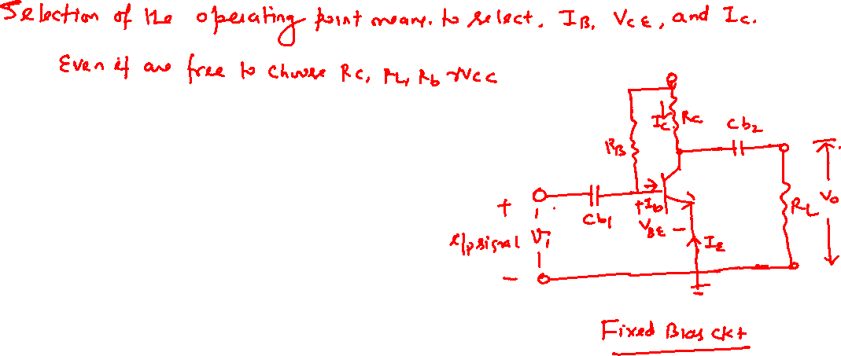
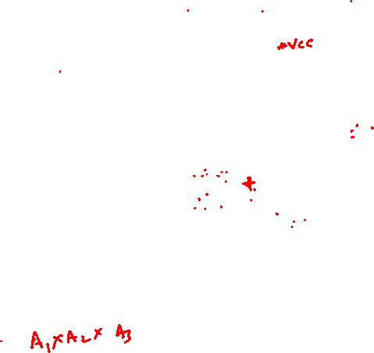
Transistor Biasing

Slide 3
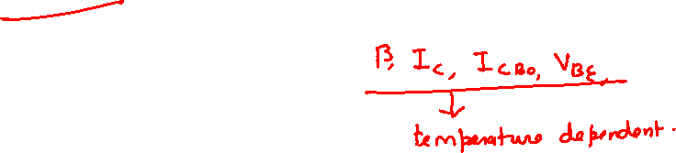

Transistor Biasing
Biasing and Bias Stability
Biasing refers to the establishment of suitable dc values of different currents and voltages of a transistor.
Through proper biasing, a desired quiescent operating point of the transistor amplifier in the active region (linear region) of the characteristics is obtained.
The selection of a proper quiescent point generally depends on the amplitude of the signal to be handled by the amplifier and distortion level in signal.

Slide 4
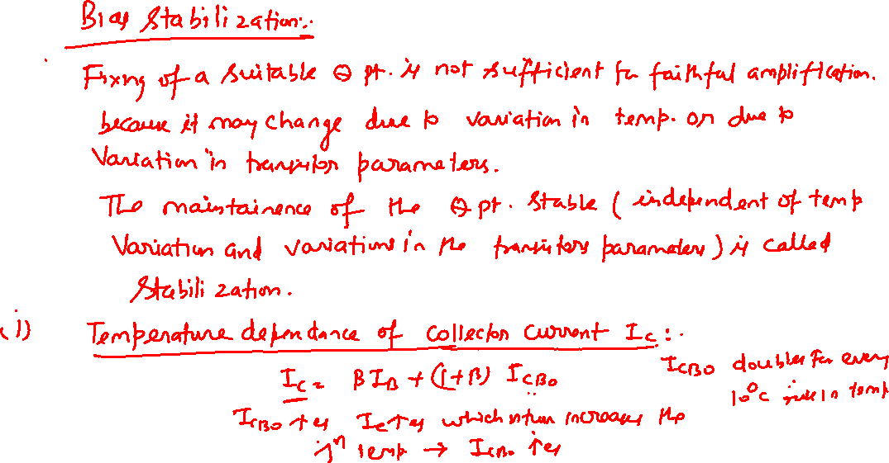
Transistor Biasing

Slide 5
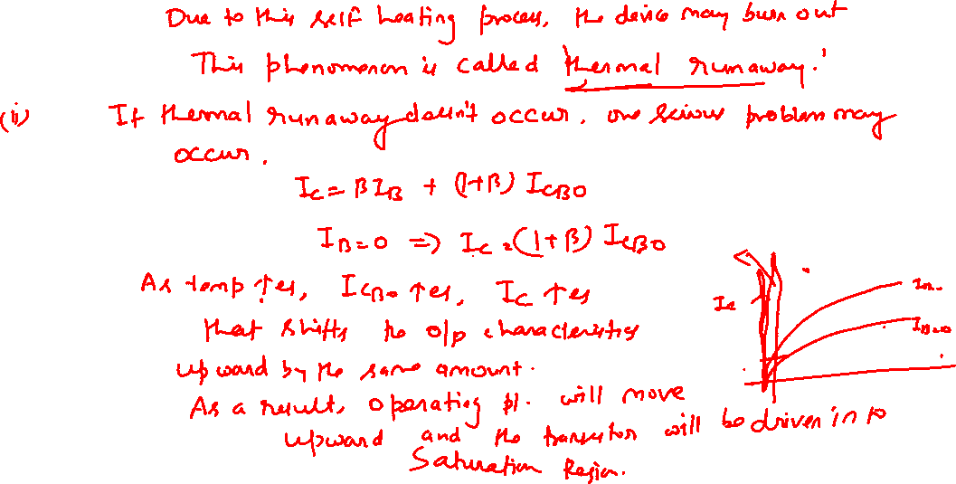
Transistor Biasing

Slide 6
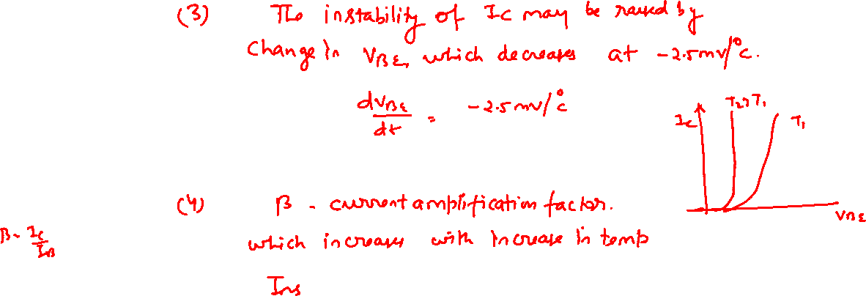
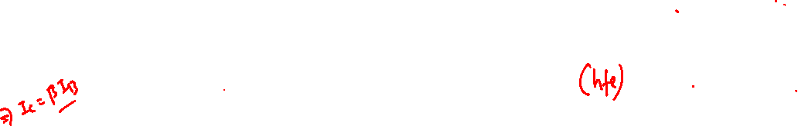
Transistor Biasing

Slide 7
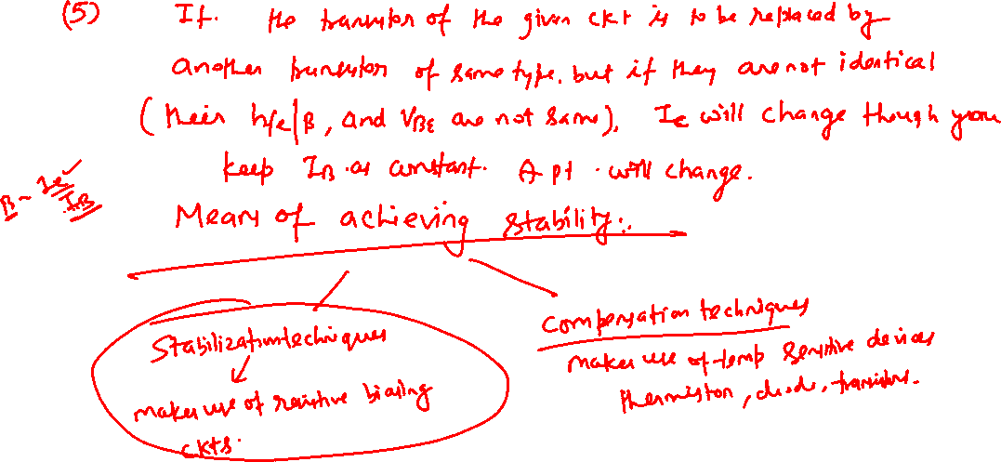

Transistor Biasing

Slide 8
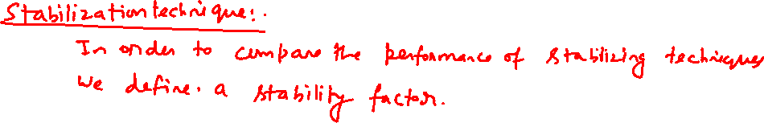
Transistor Biasing

Slide 9



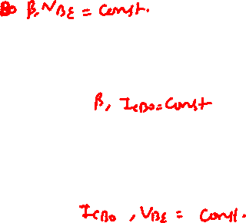
Transistor Biasing
Stability Factor
Stability Factor S:- The stability factor S, as the change of collector current with respect to the reverse saturation current, keeping β and V_{BE} constant. This can be written as:
Stability Factor S’:- The variation of I_{C} with V_{BE} is given by the stability factor S defined by the partial derivative:
Stability Factor S″:- The variation of I_{C} with respect to β is represented by the stability factor, S'', given as:

Slide 10
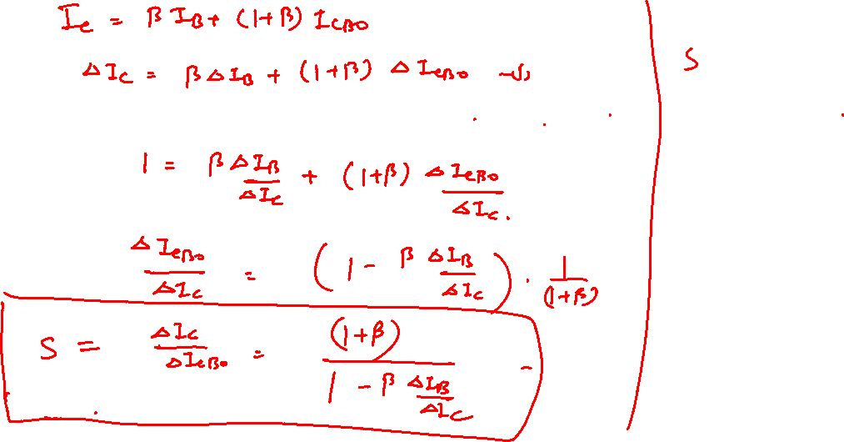
General Expression for Stability Factor

Slide 11
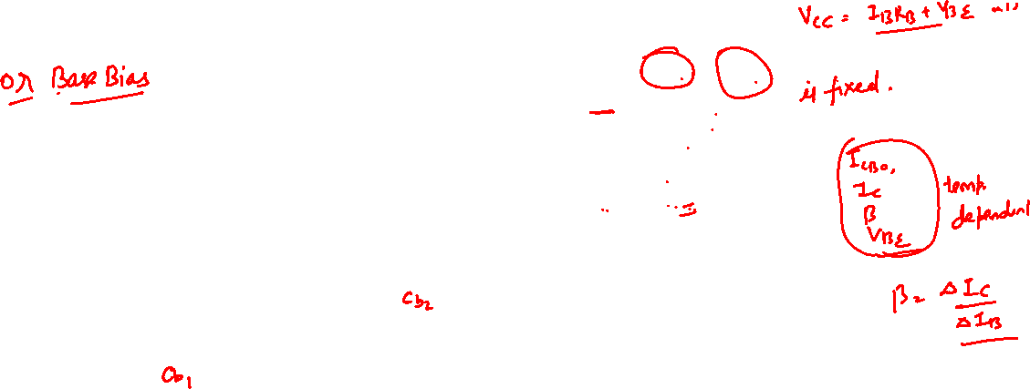

Transistor Biasing
Fixed Bias Circuit
β = dc current gain = h_{FE}

Slide 12
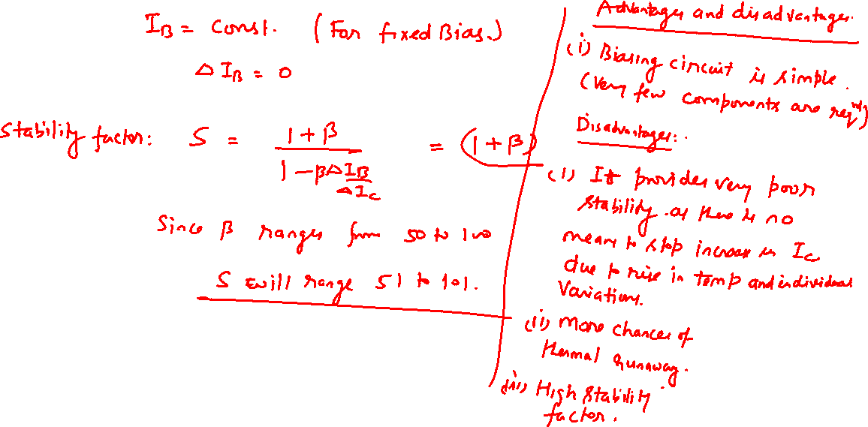

Transistor Biasing

Slide 13
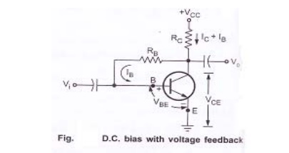
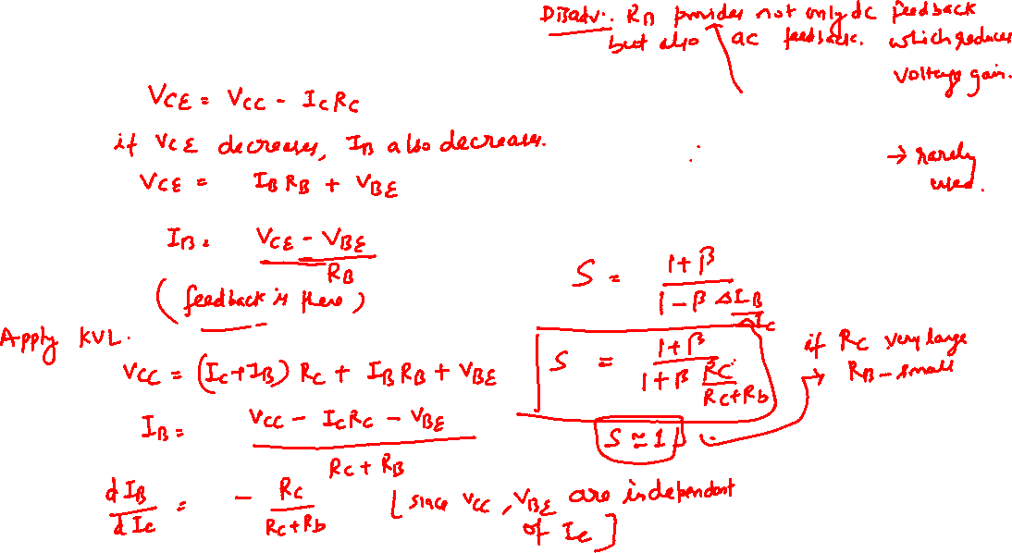
Transistor Biasing
Collector to Base Bias Circuit

Slide 14
Transistor Biasing
Collector to Base Bias Circuit

Slide 15
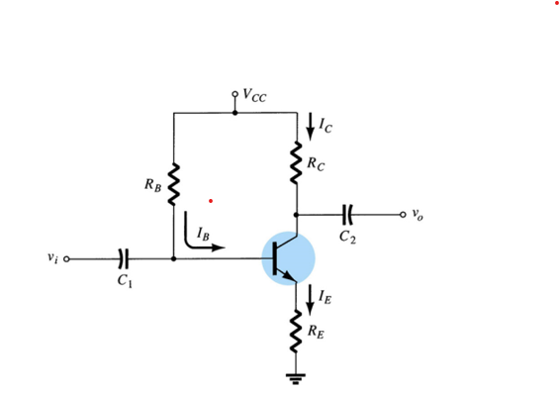
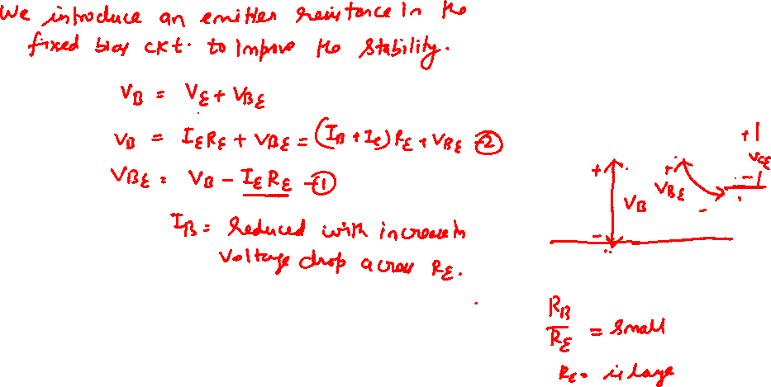
Transistor Biasing
Emitter Bias Circuit

Slide 16
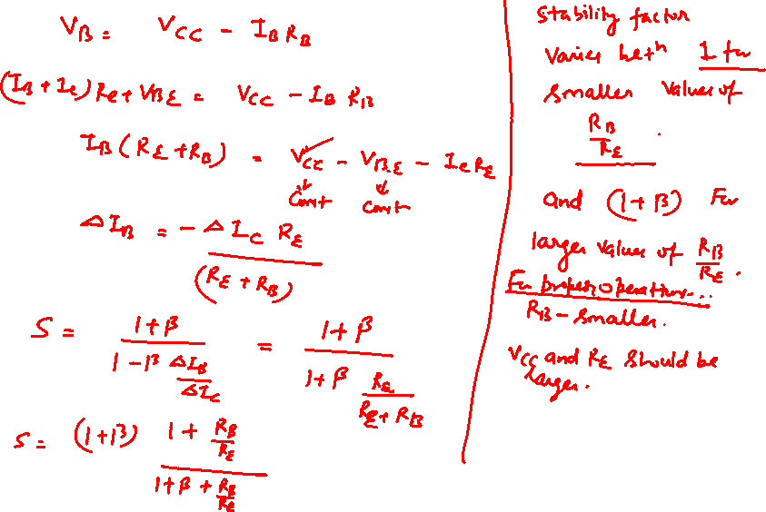

Transistor Biasing

Slide 17
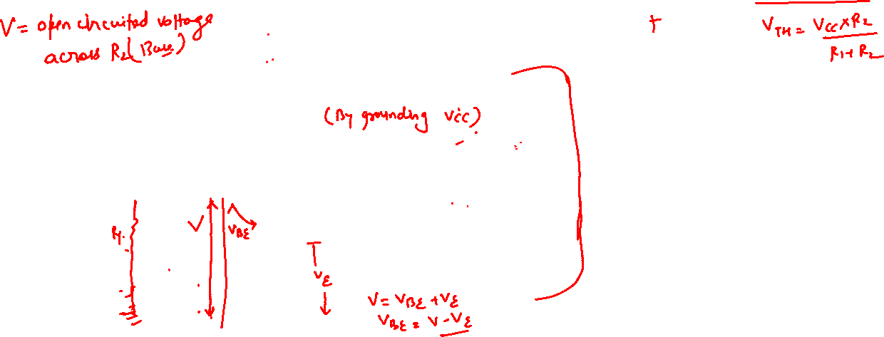
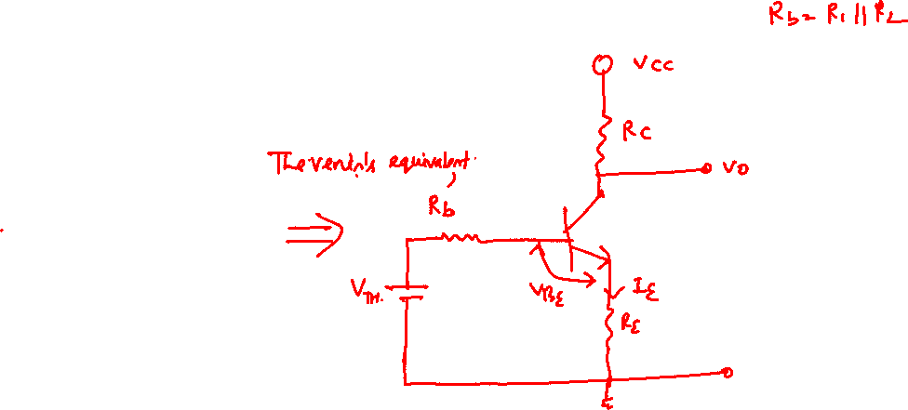
Transistor Biasing
Potential Divider /Self Bias Circuit

Slide 18
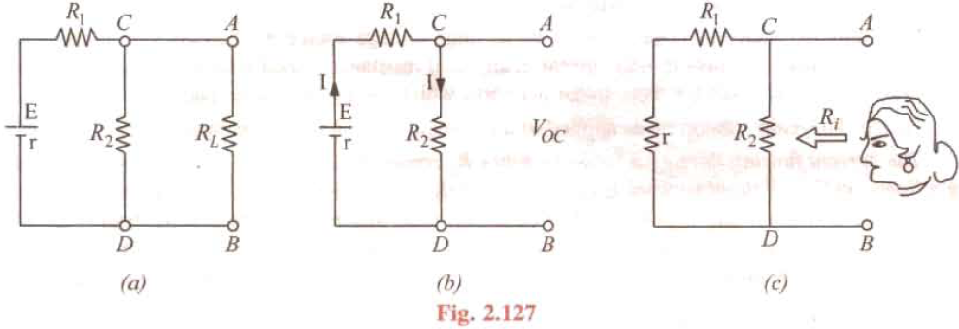
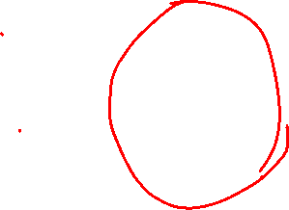

Thevenin’s Theorem
Thevenin Theorem: provides a mathematical technique for replacing a given network, as viewed from two output terminals, by a single voltage source with a series resistance. We will proceed as under:
Remove R_{L} from the circuit terminals A and B and redraw the circuit as shown in Fig. 2.127(b). Obviously, the terminals have become open-circuited.
Calculate the open-circuit voltage V_{OC} which appears across terminals A and B when they are open i.e. when R_{L} is removed. As seen, V_{OC} =drop across R₂=IR₂ where I is the circuit current when A and B are open.

Slide 19


Thevenin’s Theorem
Now, imagine the battery to be removed from the circuit, leaving its internal resistance r, if any, or zero behind and redraw the circuit, as shown in Fig. 2.127 (c). When viewed inwards from terminals A and B, the circuit consists of two parallel paths: one containing R₂ and the other containing (R₁ + r). The equivalent resistance of the network, as viewed from these terminals is given as R = R2 ||(R1+r). This resistance is called R_{i} or R_{TH} and VOC is called V_{TH}.

Slide 20
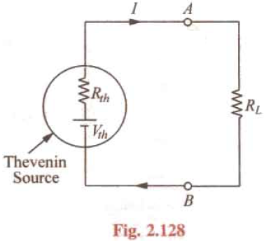
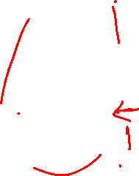
Thevenin’s Theorem
Consequently, as viewed from terminals A and B, the whole network (excluding R_{L}) can be reduced to a single source (called Thevenin's source) whose e.m.f. equals V_{OC} (or V_{TH}) and whose internal resistance equals R_{TH}(Thevenin’s resistance or R_{i}) as shown in Fig. 2.128.

Slide 21
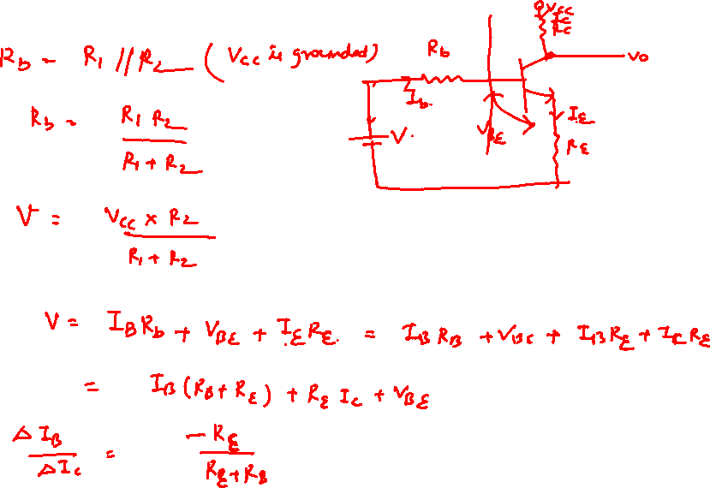

Transistor Biasing

Slide 22
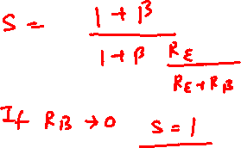
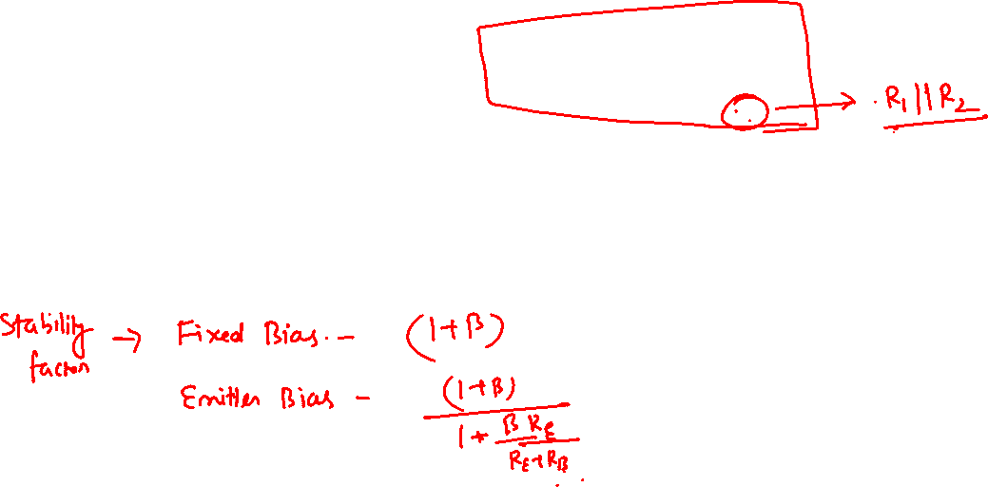


Transistor Biasing

Slide 23
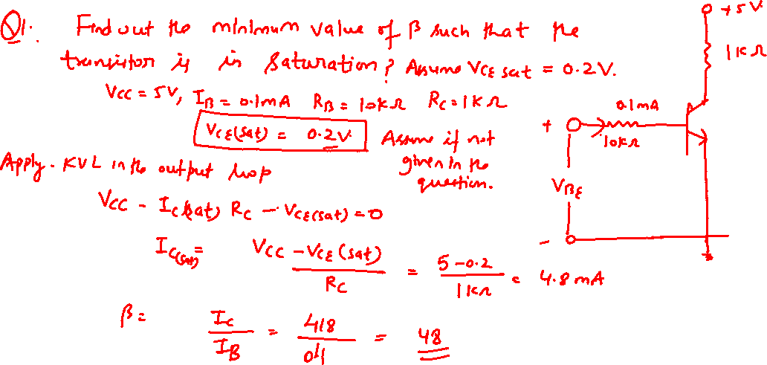
Transistor Biasing

Slide 24
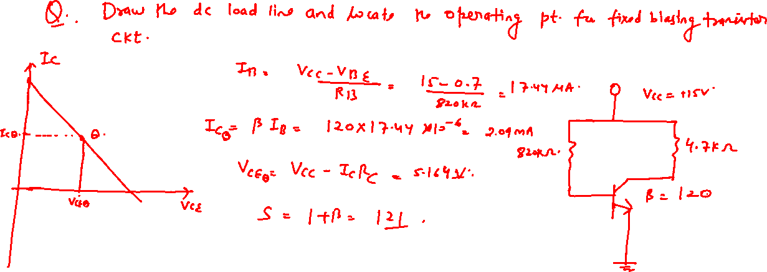
Transistor Biasing

Slide 25
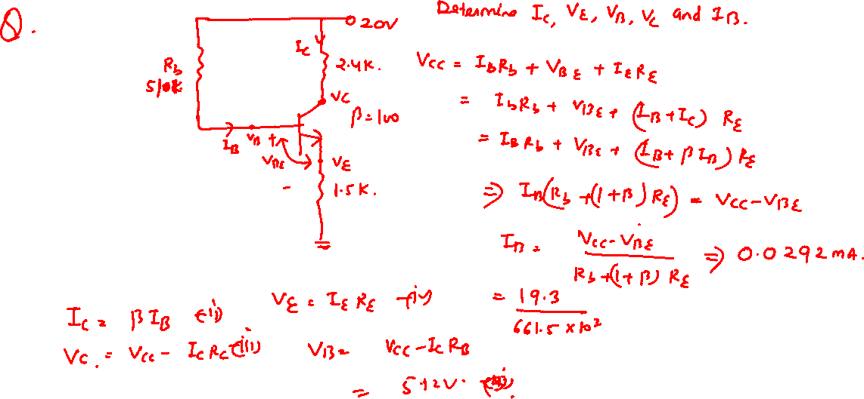
Transistor Biasing

Slide 26
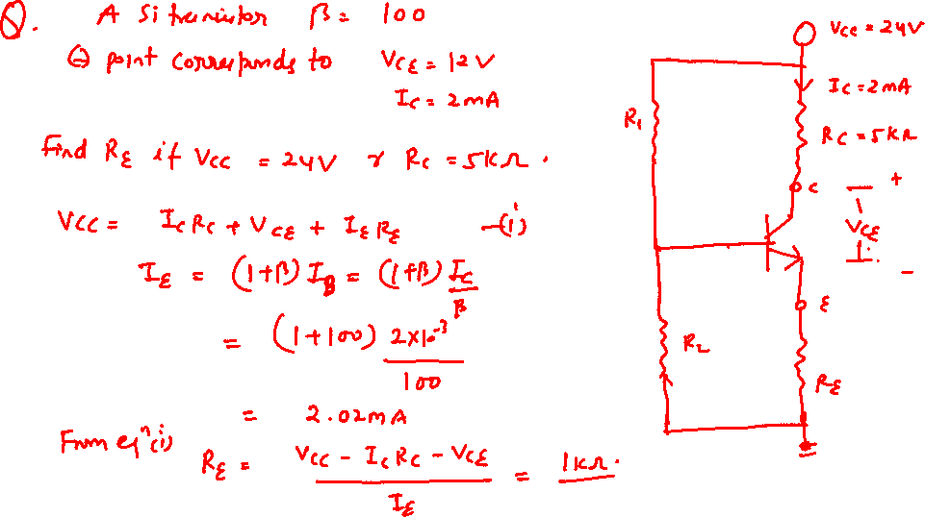
Transistor Biasing

Slide 27
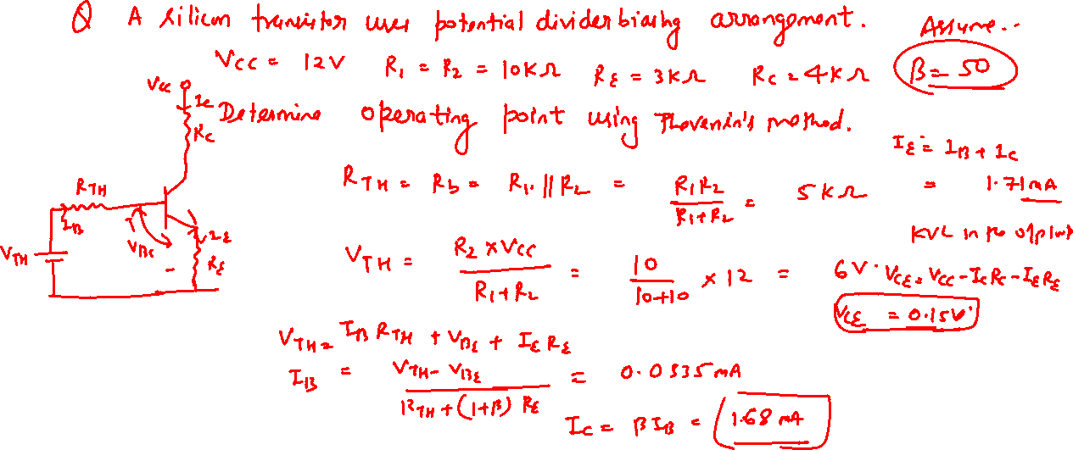
Transistor Biasing

Slide 28
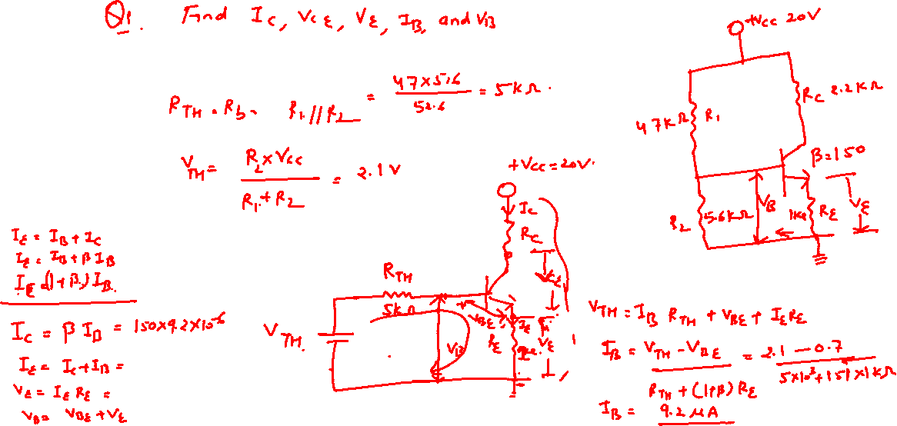


Transistor Biasing

Slide 29
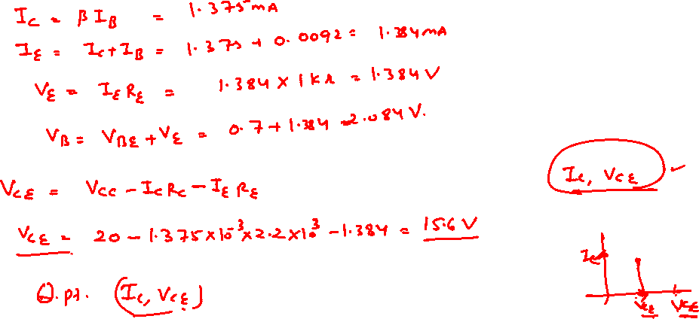
Transistor Biasing

Slide 30
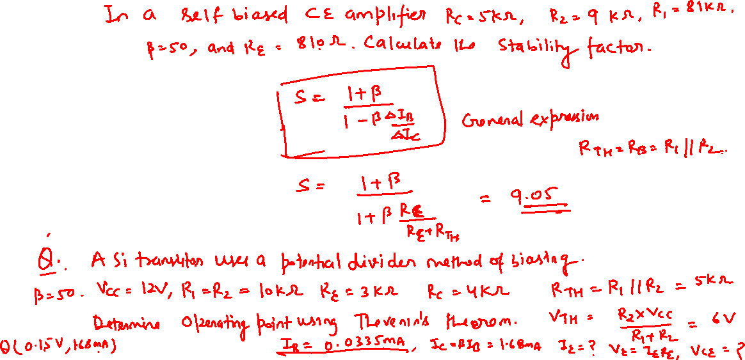

Transistor Biasing

Slide 31
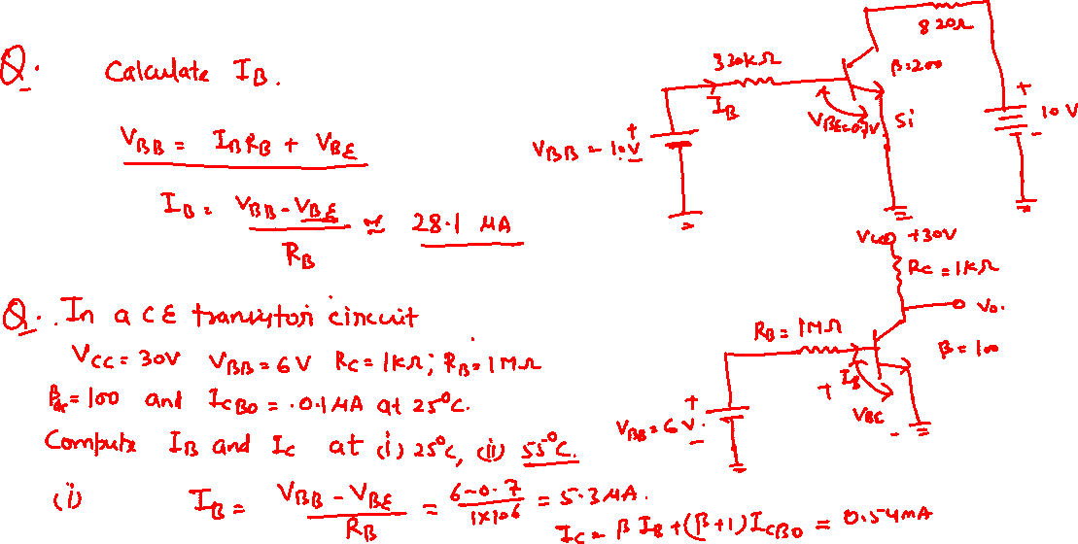

Transistor Biasing

Slide 32
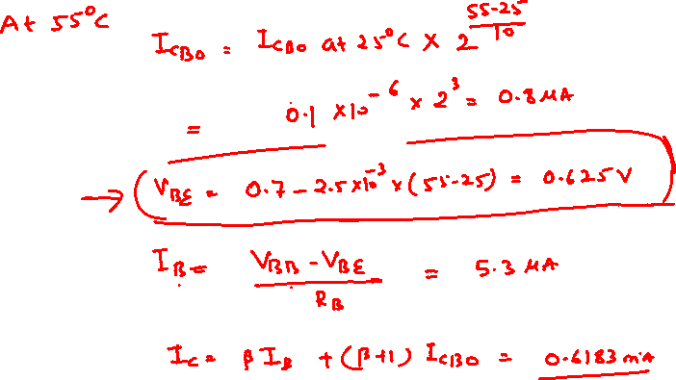
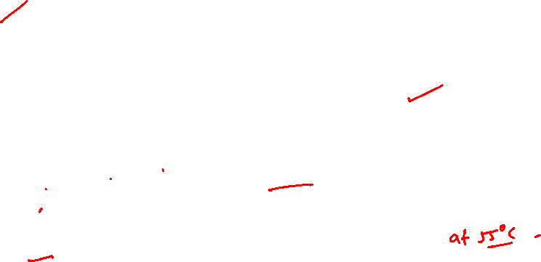
Transistor Biasing

Slide 33
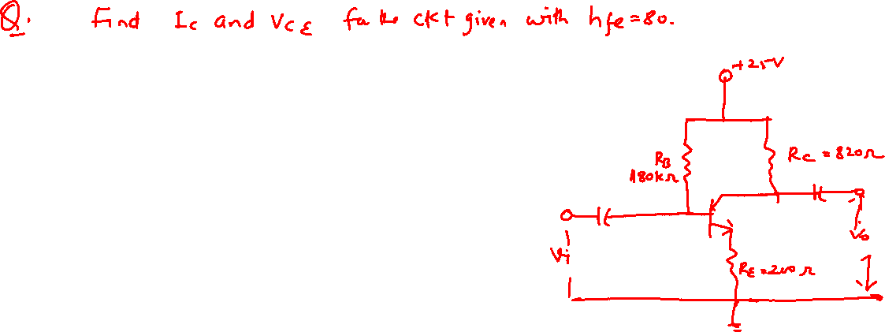
Transistor Biasing

